Slide 1
WELCOME
Presented by
Md. Al-Mamun Riyadh
2013-2-60-060
Al Muttakin
2013-2-60-005
Md. Shahriar Hassan
ID:2013-3-60-028

Slide 2
Cell Operating System and its Compilation Process

Slide 3
Introduction
Biological approaches in technology.
Neural Networking
Genetic Algorithm
An improved operating system similar to MOLECULAR BIOLOGY CONTROL SYSTEM.

Slide 4
General Concept
To Solve the
Security
Reliability
Blocked Process and
Deadlock
Task Efficiency
issues using bionic approach

Slide 5
Cell
Cell – An active autonomous agent with sensors.
A cell operating system resides in chromosomes.
Receives signal from the environment and surrounding cellular bodies and respond to them.
Think of a similar OS that will respond to the Neural signal from the user!!!

Slide 6
Cell Control Structure

Slide 7
Cell Control Structure (cont…)
Different Level of Processing in Prokaryotic cell
DNA level
RNA level
Protein level
Metabolism

Slide 8
Cell Control Structure (cont…)
Different Level of Control Structure in Prokaryotic cell
Operons (Deals with group of genes)
Regulons (Deals with group of operons and genes)
Modulons (Deals with group of operons, regulons and genes)
Unknown
Control structure of Eukaryotic cells are even more complex.

Slide 9
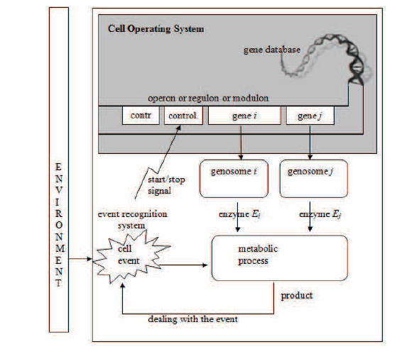
Cell Operating system

Slide 10
Cell Operating system (cont…)
All the cell structure is some how co-ordinated
When a cell undergo any process for example replication all other processes support the oriented process
So how they co-ordinate with the on going process??

Slide 11
Cell Operating system (cont…)
How about a general control structure that orchestrate the priority of a cell activity??
This hypothesis leads to the existence of a Cell Operating System (COS)
A database operating system to handle gene database.

Slide 12
Comparison
Computer OS should be able to handle
System Complexity
Program Preparation
Resource management and processing
Memory management
Security with others
Lets see how COS handle some of this issues…..

Slide 13
Controlling System Complexity
A parallel distributed processing system of up to a thousand processor executing their programs written in genome, working over five thousand resource segment.

Slide 14
Cell files
The transcription unit is analogous to cell files
DNA eventually transcript to RNA
Precursor RNA contains the information of a single gene
In eukaryotic cell files are rather complex.
Contains segment of gene
Busy files are segmented

Slide 15
Program Preparation
mRNA as source code
Protein as compiler
rRNA as executable file

Slide 16
Problems with existing Operating systems
Security issues and reliability.
Linux kernel has 2.5 million lines of code. Windows XP kernel has 5 million lines of code. They are obviously huge and potentially unreliable and insecure.
Computer viruses and other invasive software made a paradigm shift in OS design changing the normal approach of OS towards security and reliability oriented issues.

Slide 17
Solutions ???
Security Issue
Deadlock

Slide 18
Future Work
Cloud Operating System.
Data Sorting.
File Management.
Forensic Reason.
Convert volatile Memory to non-volatile memory.

Slide 19
Thank You
Any Question ?

